Slide 1
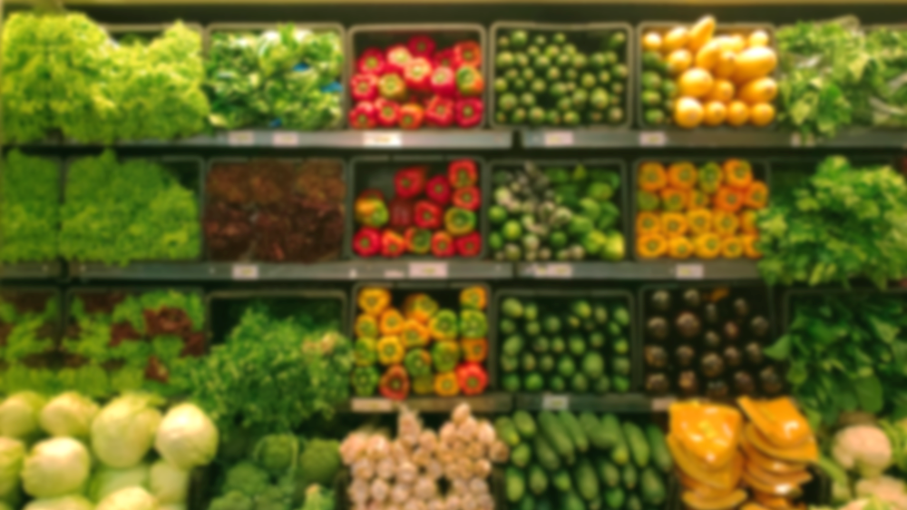
IOT APPLICATION FOR GROCERIES
TEAM 19 MINA JANG ANDREW BURCH JOSH WELSH

Slide 2
TABLE
PROJECT OVERVIEW
SYSTEM OVERVIEW
SYSTEM DIAGRAM
SYSTEM ARCHITECTURE
SEQUENCE DIAGRAM
CLASS DIAGRAM
DESIGN PATTERN

Slide 3
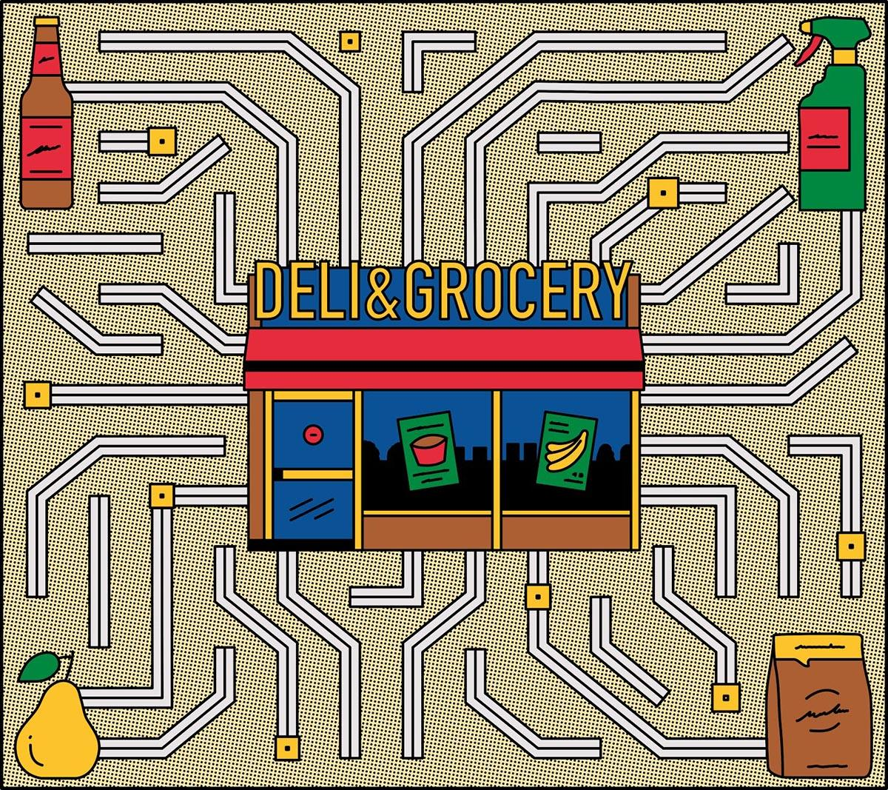
PROJECT OVERVIEW
IOT FOR GROCERIES
BARCODE READABILITY SCAN BARCODE TO RETRIEVE GROCERY INFORMATION
EXPIRATION DATE ACCESSING DATABASE TO FETCH EXPIRATION INFORMATION
PROVIDE RECIPE RECIPE SEARCH ENGINE FOR EXISTING INGREDIENTS
Notes:
Explains how the application behaves

Slide 4

SYSTEM OVERVIEW
FUNCTIONALITY DATABASE GROCERY LIST ADD/DELETE NOTIFICATION RECOMMENDATION
MONGODB HIGH VOLUME DATA STORAGE RAPID GROWTH
DATABASE EXPIRATION DURATION RECIPE INFORMATION

Slide 5
Four-Tier Architecture Design
User View: React-Native
User Controller: Javascript/Nodejs
Business Logic Layer: Python
Model: MongoDB

Slide 6
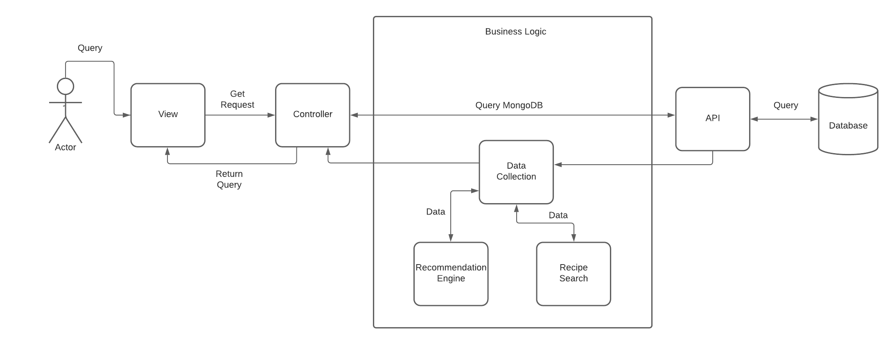
SYSTEM DIAGRAM

Slide 7

MVC FRAMEWORK
Notes:
-we use a modified MVC framework
Why MVC?
Safety, user does not directly modify DB
Testable, easy to debug

Slide 8
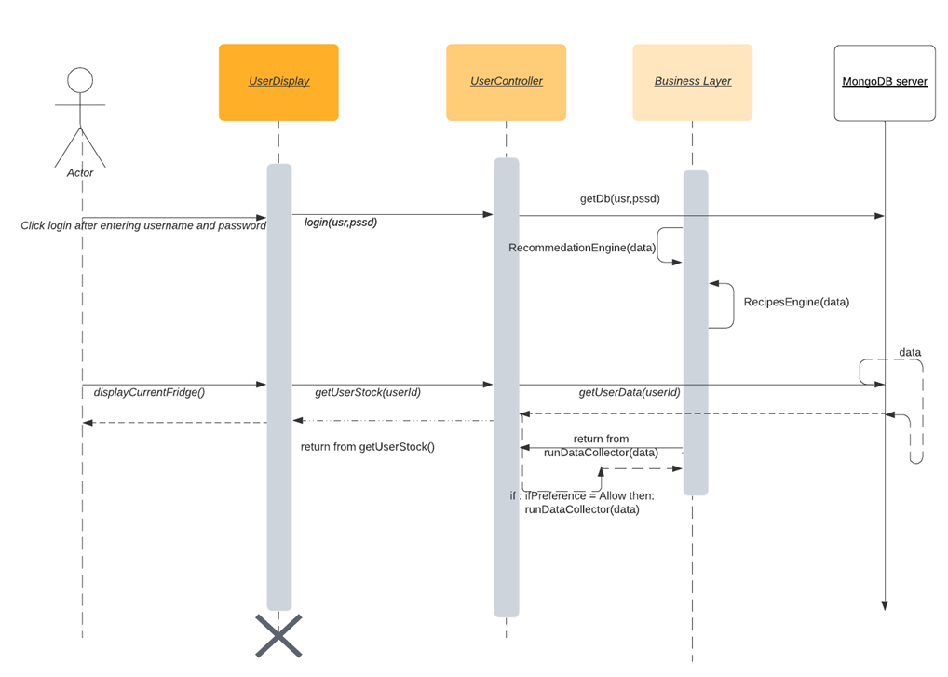
SEQUENCE DIAGRAM

Slide 9
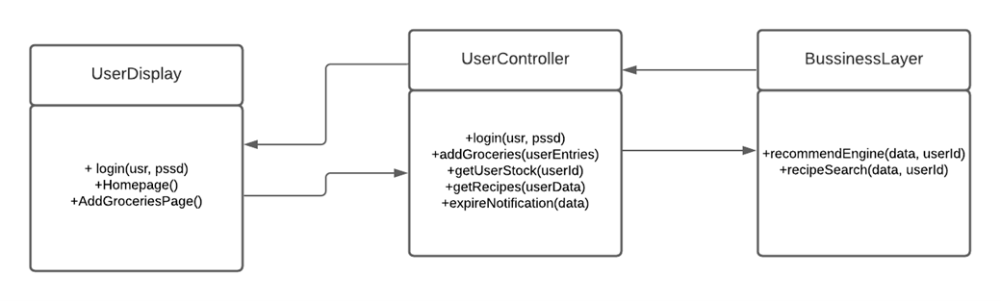
CLASS DIAGRAM

Slide 10
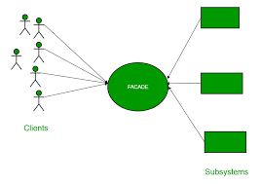
DESIGN PATTERN
FAÇADE PATTERN

Slide 11
THANK YOU FOR YOUR TIME
TEAM 19 MINA JANG ANDREW BURCH JOSH WELSH

